Slide 1


Muhammad Rafay
14th July, 2025

Slide 2

Outline
Executive Summary
Introduction
Methodology
Results
Conclusion
Appendix

Slide 3
Executive Summary
The projects aims to gain insights on the past information regarding successful or failed rocket launches by SpaceX. Using the data gathered from SpaceX, the project aims to develop a model to predict whether the next SpaceX Falcon 9 Rocket will make a successful landing.
A Decision Tree Classifier model was developed using this data, with the best accuracy score of 88.8% with the help of various parameters which include:

Slide 4
Introduction
We will follow the Data Science methodology involving data collection, data wrangling, exploratory data analysis, data visualization, model development, model evaluation, and reporting the results to stakeholders.
We must predict if the first stage of the SpaceX Falcon 9 rocket will land successfully. With the help of Data Science findings and models, so market competitors can make more informed bids against SpaceX for a rocket launch.

Slide 5

Section 1

Slide 6
Methodology
Executive Summary
Data collection methodology:
SpaceX REST API, Wikipedia
Perform data wrangling
To wrangle data with the help of Pandas (Python) and SQL
Perform exploratory data analysis (EDA) using visualization and SQL
Perform interactive visual analytics using Folium and Plotly Dash
Perform predictive analysis using classification models
To build, tune, evaluate classification models

Slide 7
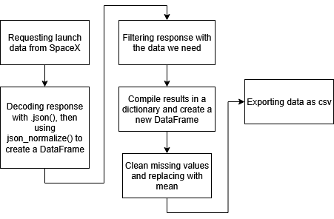
Data Collection – SpaceX API
Presenting data collection with SpaceX REST calls using flowcharts
Resources involving the data collection utilizing the SpaceX API are included in the Jupyter Notebook linked below: https://github.com/muhammadrafayasif/spacex-success-prediction/blob/main/jupyter-labs-spacex-data-collection-api.ipynb

Slide 8
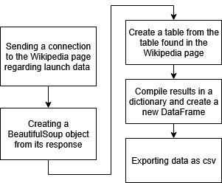
Data Collection – Scraping
Present your web scraping process using key phrases and flowcharts
Resources involving the data collection utilizing the web scraping methods are included in the Jupyter Notebook linked below: https://github.com/muhammadrafayasif/spacex-success-prediction/blob/main/jupyter-labs-webscraping.ipynb

Slide 9
Data Wrangling
Firstly, the data collected through the data collecting methods shown in the previous slides are processed with the help of Pandas (Python) and SQL (inline magic used in Jupyter Notebooks)
We clean unnecessary data and one hot encode our numeric data to further optimize model efficiency
The Jupyter Notebook including technical methods to wrangle the data are linked below: https://github.com/muhammadrafayasif/spacex-success-prediction/blob/main/labs-jupyter-spacex-Data%20wrangling.ipynb

Slide 10
EDA with Data Visualization
Using the wrangled data, we visualize our data into graphs to gain meaningful insights, such as how success in launches vary by location, weight or by time.
We can visualize our data to gain information on how each characteristic of the rocket influences its success and how the issues are being resolved as time passes
We use scatter plots, bar plots and line plots in this scenario tailored towards the attributes of the rocket
The Jupyter Notebook including technical methods to wrangle the data are linked below: https://github.com/muhammadrafayasif/spacex-success-prediction/blob/main/edadataviz.ipynb

Slide 11
EDA with SQL
We use SQL to gain information on how successful launches and landings are influenced by certain characteristics in the rocket.
We also gain information on how the failure of each rocket causes the same issues to occur less frequently as time passes
With SQL, we can easily understand how location and mass play an important role on the success of rocket launches.
The Jupyter Notebook including technical methods to wrangle the data are linked below: https://github.com/muhammadrafayasif/spacex-success-prediction/blob/main/jupyter-labs-eda-sql-coursera_sqllite.ipynb

Slide 12
Build an Interactive Map with Folium
Using Folium (A map plotting library in Python), we can locate the coordinates of each of the launch sites which play a pivotal role on the success and failure of launches.
We realize that rockets are launched close to the boundaries of water bodies for the easy retrieval of rockets and minimal loss to man-made creations or the environment
We use markers, lines and clusters to identify each launch site, we also can click the clusters to gain insights on the success and failure rate of each specific launch site.
The Jupyter Notebook including technical methods to wrangle the data are linked below: https://github.com/muhammadrafayasif/spacex-success-prediction/blob/main/lab_jupyter_launch_site_location.ipynb

Slide 13
Build a Dashboard with Plotly Dash
Using Dash, we create interactive dash boards which can showcase data in specific areas without having to manually graph each specific scenario.
We can deduce the most successful launch site with the help of interactive dashboards
We can deduce how the Payload Mass is related to the success and failure of launches by using an interactive slider.
The Jupyter Notebook including technical methods to wrangle the data are linked below: https://github.com/muhammadrafayasif/spacex-success-prediction/blob/main/spacex-dash-app.py

Slide 14
Predictive Analysis (Classification)
After cleaning our data and applying pre-processing methods to our dataset, We implement training with various models.
We train this dataset with multiple models which include:
Logistic Regression
Support Vector Machine
Decision Tree
K Nearest Neighbors
The Jupyter Notebook including technical methods to wrangle the data are linked below: https://github.com/muhammadrafayasif/spacex-success-prediction/blob/main/SpaceX_Machine%20Learning%20Prediction_Part_5.ipynb

Slide 15


Slide 16
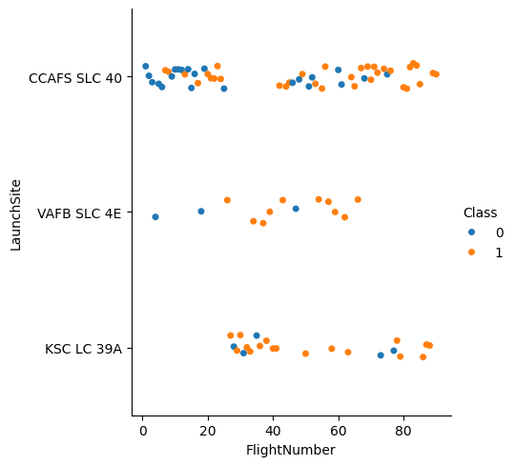
Flight Number vs. Launch Site
The number of successful launches increase with time
CCAFS SLC 40 is the most primarily used launch site

Slide 17
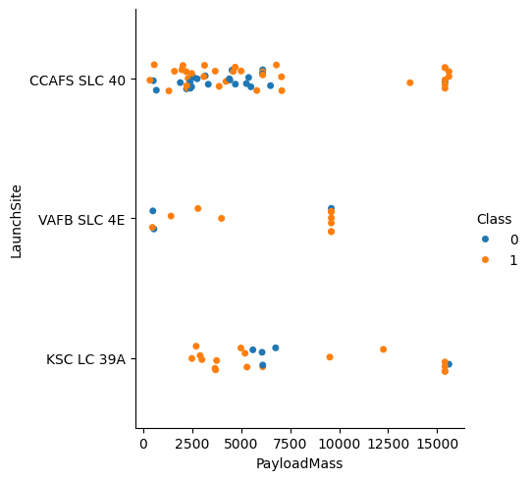
Payload vs. Launch Site
VAFB-SLC launches no rockets with Payload Mass (10000>).

Slide 18
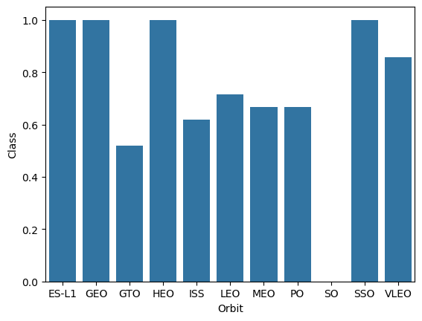
Success Rate vs. Orbit Type
ES-L1, GEO, HEO and SSO are the most successful orbit types.

Slide 19
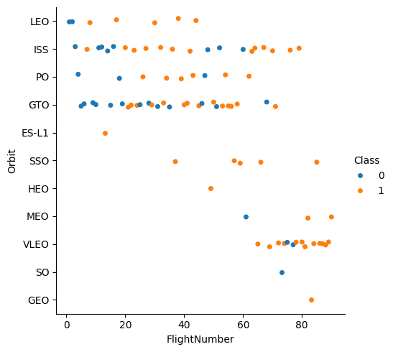
Flight Number vs. Orbit Type
Success increases with the number of flights

Slide 20
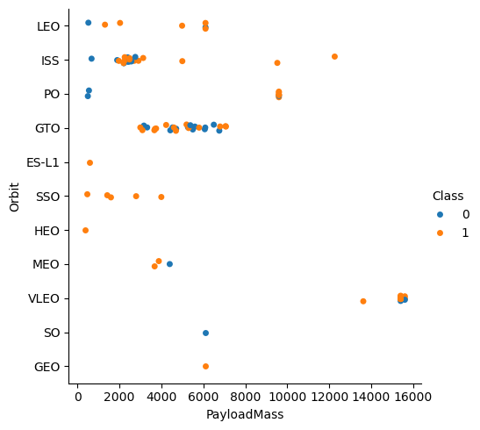
Payload vs. Orbit Type
Payload Mass (between 2000 and 8000) mostly take place in GTO

Slide 21
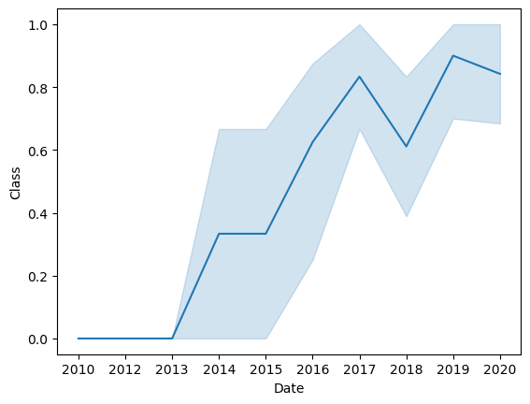
Launch Success Yearly Trend
This tells us the success of rocket launches increases with time.

Slide 22
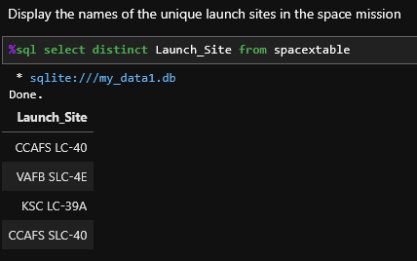
All Launch Site Names

Slide 23
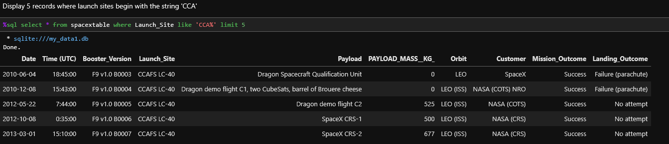
Launch Site Names Begin with 'CCA'

Slide 24
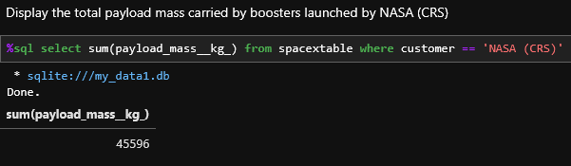
Total Payload Mass

Slide 25
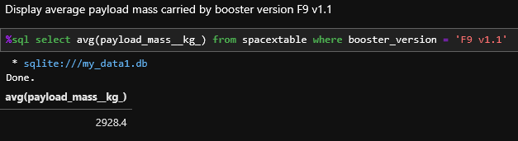
Average Payload Mass by F9 v1.1

Slide 26
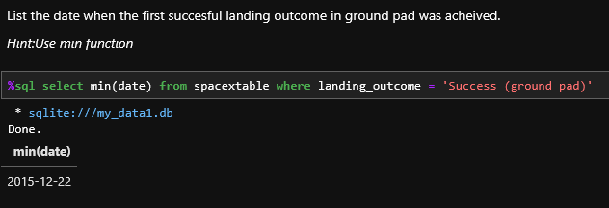
First Successful Ground Landing Date

Slide 27
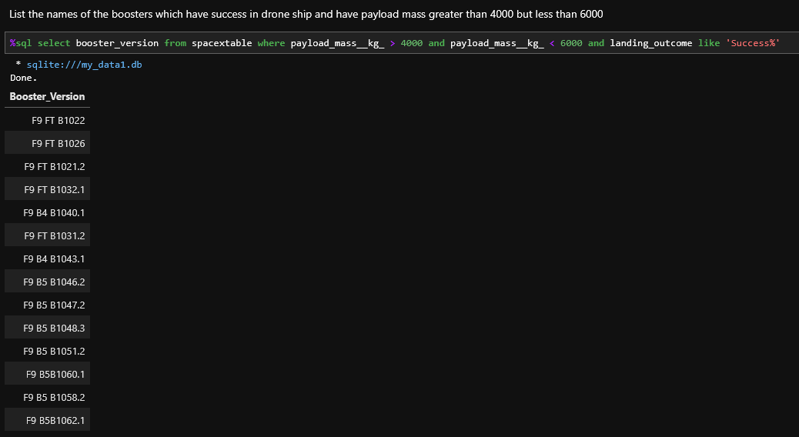
Successful Drone Ship Landing with Payload between 4000 and 6000

Slide 28
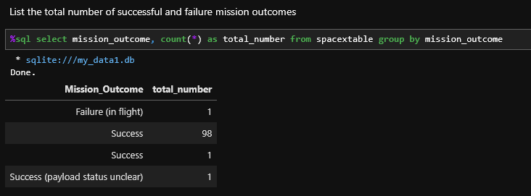
Total Number of Successful and Failure Mission Outcomes

Slide 29
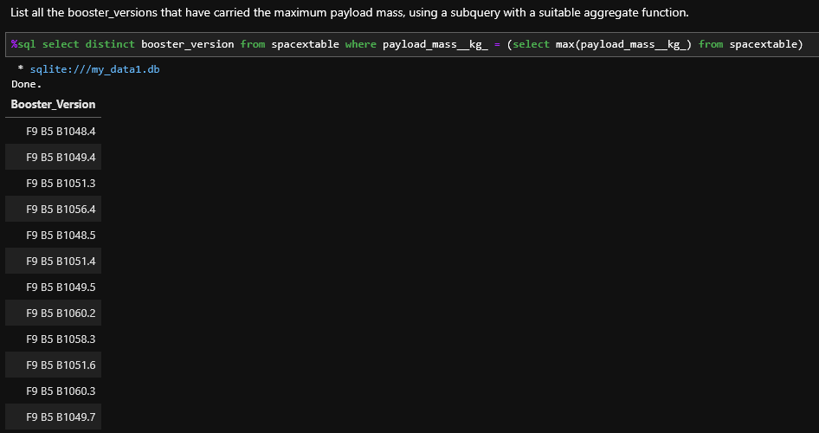
Boosters Carried Maximum Payload

Slide 30
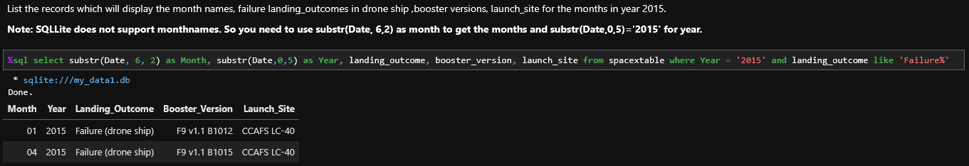
2015 Launch Records

Slide 31
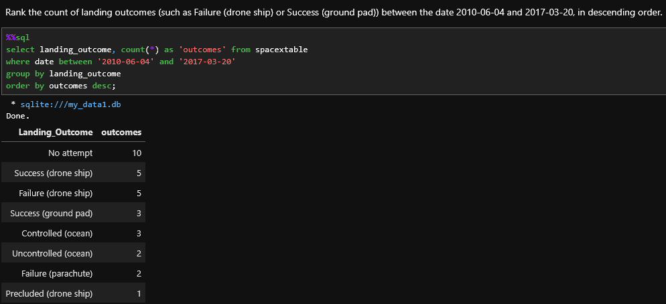
Rank Landing Outcomes Between 2010-06-04 and 2017-03-20

Slide 32


Slide 33
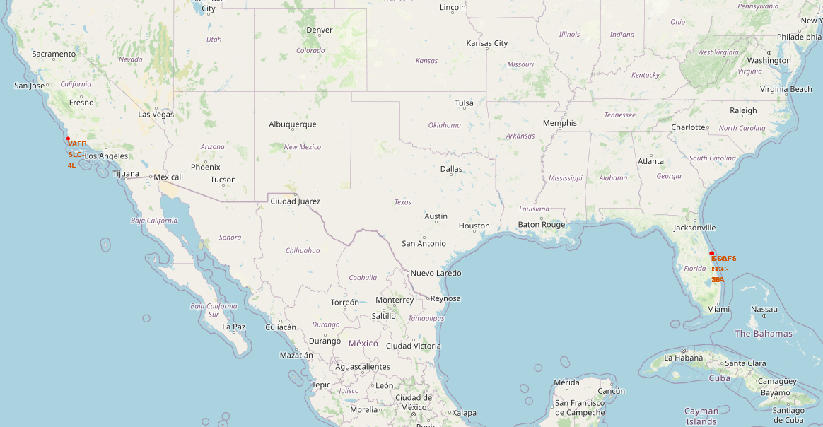
Location of All Launch Sites
All Launch Sites are marked, they are nearby water bodies.

Slide 34
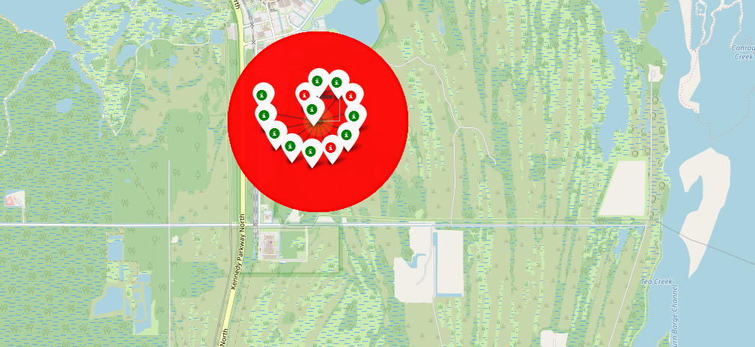
Marking Successful/Failure in Launch Sites
The success and failure of launches are available in marker clusters.

Slide 35
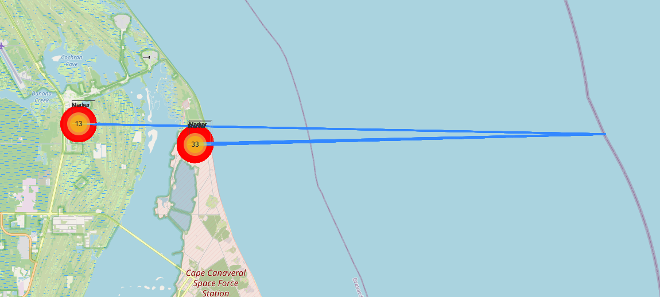
The importance of Launch Site locations
All launch sites are close to water bodies.

Slide 36


Slide 37
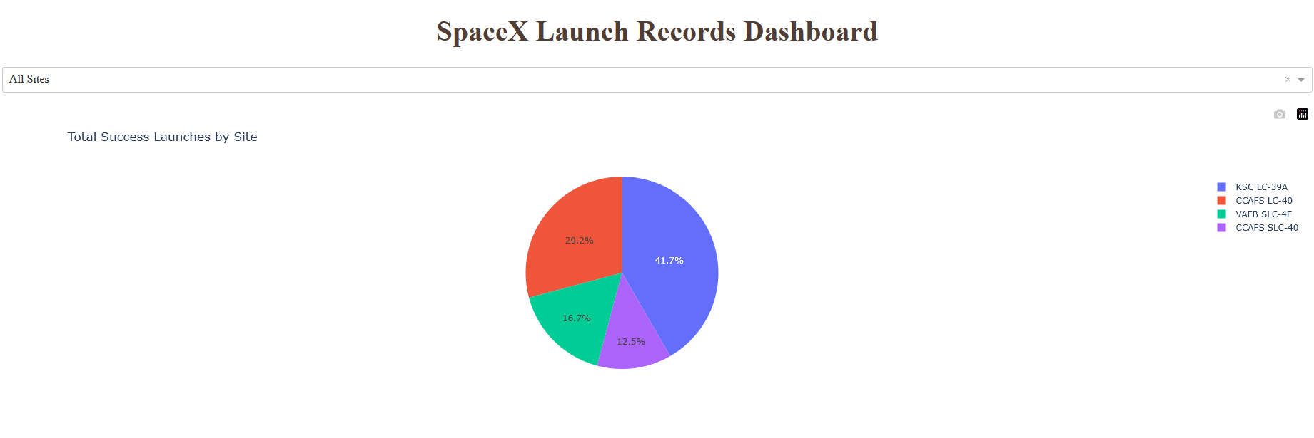
Total Successful Launches by Site
The launch site KSC LC-39A has the most successful launch ratio.

Slide 38
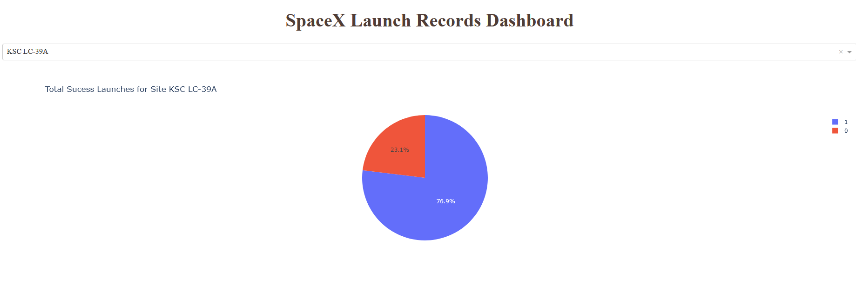
Most Successful Launch Site
76.9% of launches in KSC LC-39A were successful

Slide 39
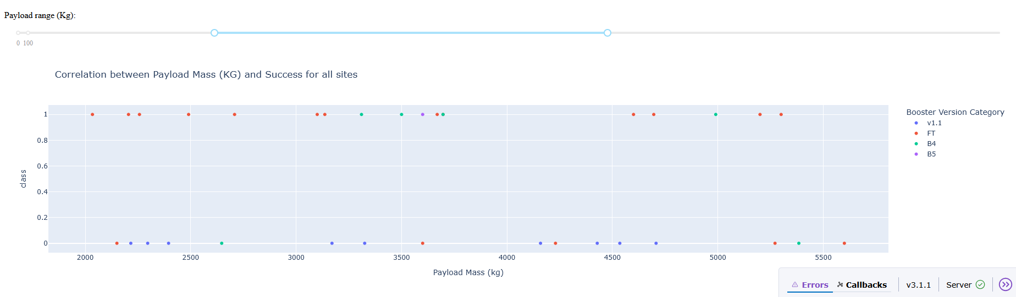
Correlation between Payload Mass and Success
Most successful launches were from the Booster Version FT, and launches are more successful with lighter Payload Mass (KG)

Slide 40


Slide 41
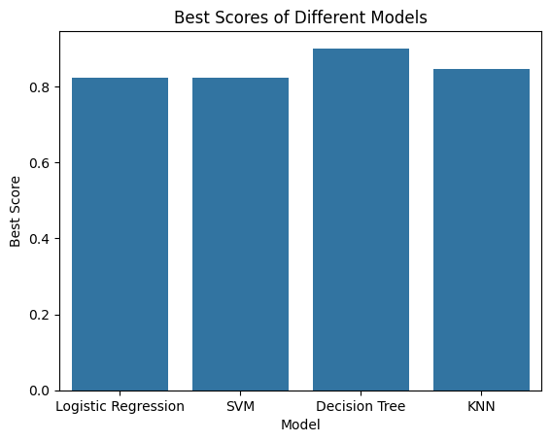
Classification Accuracy
According to the above bar chart, the Decision Tree outperforms the others.

Slide 42
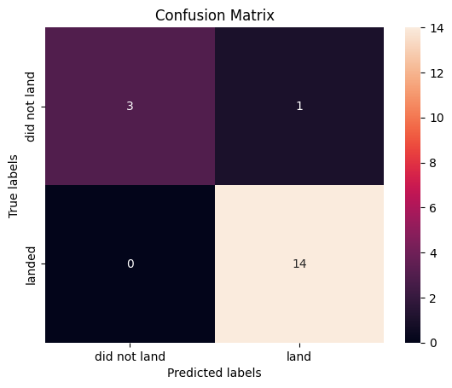
Confusion Matrix
Confusion Matrix of Decision Tree

Slide 43
Conclusions
According to the calculated best scores of 4 different models which include:
Logistic Regression
SVM
Decision Tree
KNN
The Decision Tree performs the best with a best score of 88.8%, which is the model decided to predict the successful landing of the Falcon 9

Slide 44
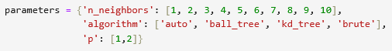
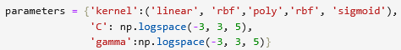
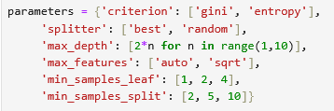
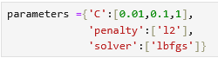
Appendix
KNN
SVM
Decision Tree
KNN

Slide 45


